Slide 1

Presentation on
Presented by
Trupti Laxman Lamkane

Slide 2
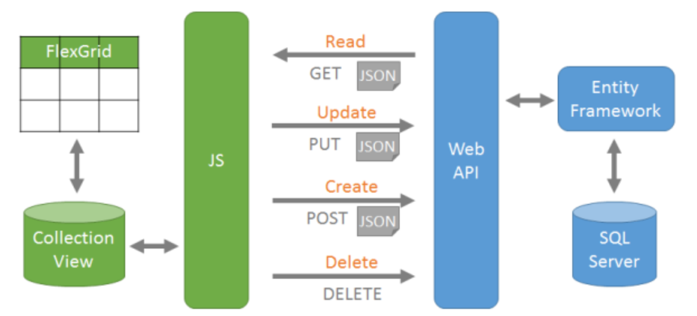
Fig:Flow chart

Slide 3
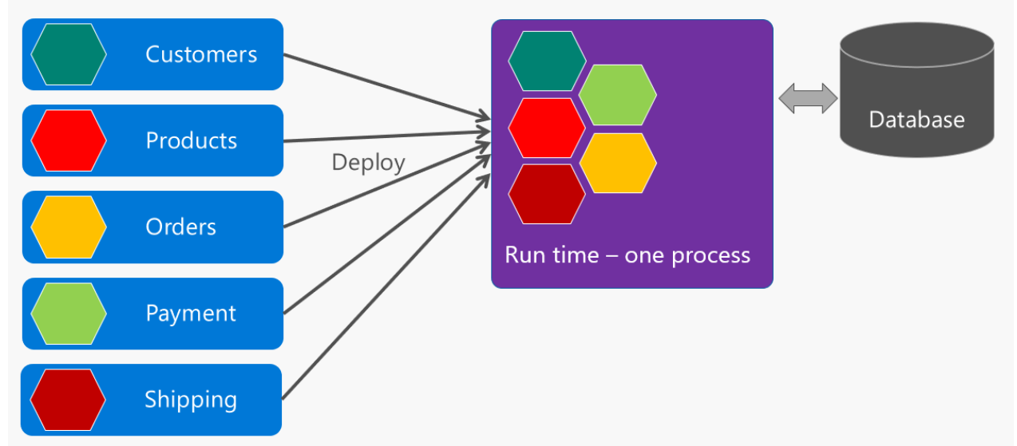
Fig: Ecommerce

